Slide 1
CS 6476 PS 0
Karan Sarkar
ksarkar9@gatech.edu
903569592

Slide 2
Instructions
Do not change format or add pages. If you do, you might not receive full score
Images: When placing images or plots, do it at the size of the given box marked in red.
All the red text highlights where you need to fill with an answer.
Submit a pdf to Gradescope, to the assignment “PS0 – Report”

Slide 3
Part 1: Introduction to Vectors and Matrices

Slide 4
Part 1.c: After applying the vector transpose, what is the dimension of the resulting vector? (replace the values for ‘a’ and ‘b’)
Size = torch.size([1,3])

Slide 5
Part 2: Working with images

Slide 6
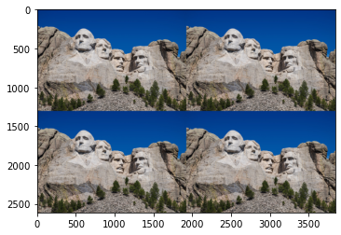
Part 2.c: Concatenation of color images. Place the result for the image concatenation.
<Plot here>

Slide 7
Extra Question: Give a brief description on how easy was for you to setup the environment and start working on the project. Is there something you found difficult during the setup of the project?
I found it all very straight forward and easy.

